Slide 1
Hotel Booking Cancellation Prediction
Data Preprocessing Pipeline

Slide 2
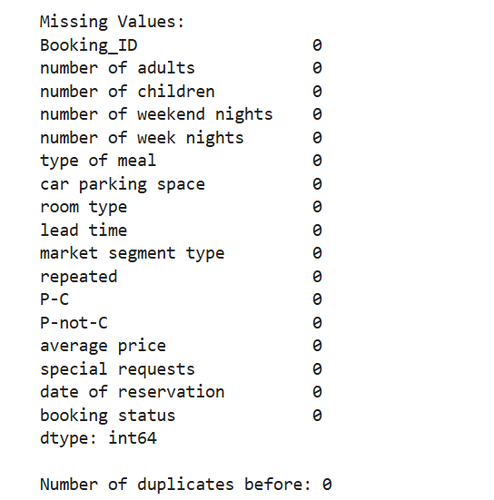
The dataset initially shows no missing values in any field—a rare but ideal scenario for real-world data! This suggests strong data collection practices or prior cleaning. However, we still implemented safeguards in our pipeline to handle potential future inconsistencies."

Slide 3
Feature Engineering – Combining repeated, P-C, and P-not-C
I created the repeat_type feature to simplify and combine the logic of three related columns: repeated, P-C, and P-not-C.
Instead of keeping all three, I mapped their combinations into one meaningful numeric feature:
0 → Not a repeated customer
1 → Repeated and completed booking
2 → Repeated but did not complete booking
This makes the data cleaner, easier to interpret, and better for modeling. I also removed rows with inconsistent values and dropped the original columns to avoid redundancy.

Slide 4
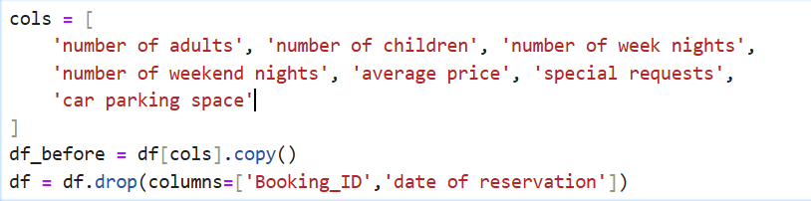
Dropped irrelevant columns,
use the relevant ones.

Slide 5
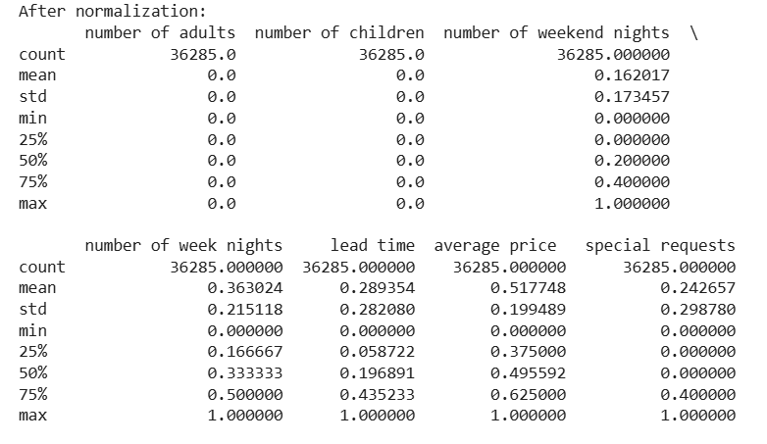
"Min-Max scaling ensures equal feature weighting in models."

Slide 6
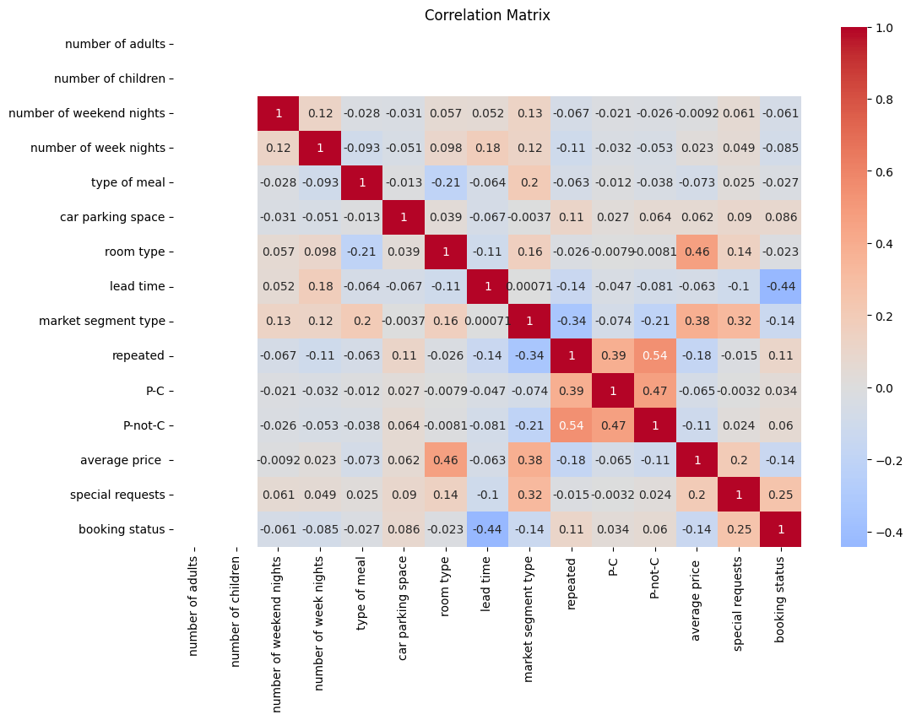
No severe correlation – all correlations < 0.8.

Slide 7
Data Transformation to handle outliers
🔹 Clipping :
Used to cap extreme values (outliers) within logical bounds
Example: number of adults clipped to max 3
This Reduces outlier impact without removing data
🔹 Log Transformation (log1p) :
Applied to skewed features to normalize distribution
Example: number of children, average price, car parking space.
Helps models perform better on non-normal data

Slide 8
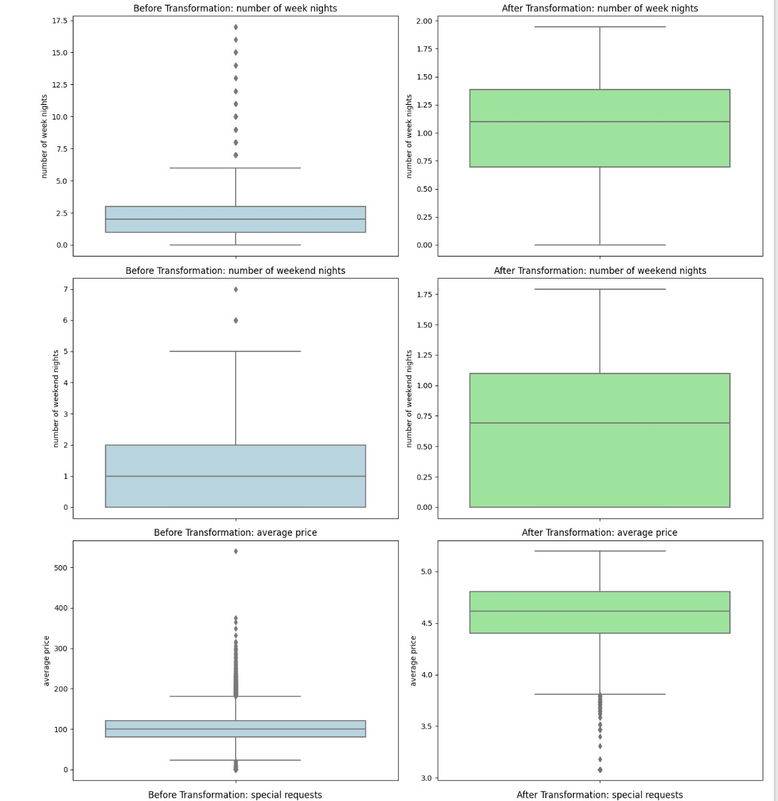
Data Before and After Transformation

Slide 9
Encoding Method
🔹 One-Hot EncodingApplied to categorical features:
(type of meal, room type, market segment type, booking status)
🔹 Converts categories into binary columns (0 or 1)
🔹 Used drop_first=True to avoid dummy variable trap

